Slide 1




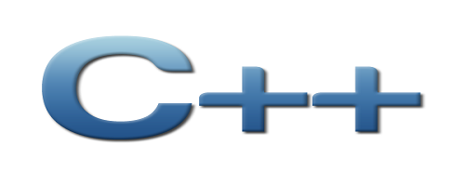
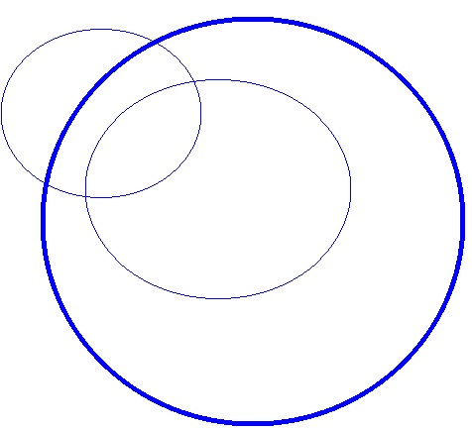
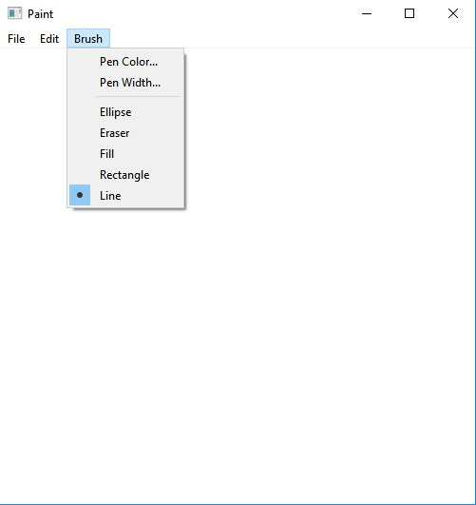
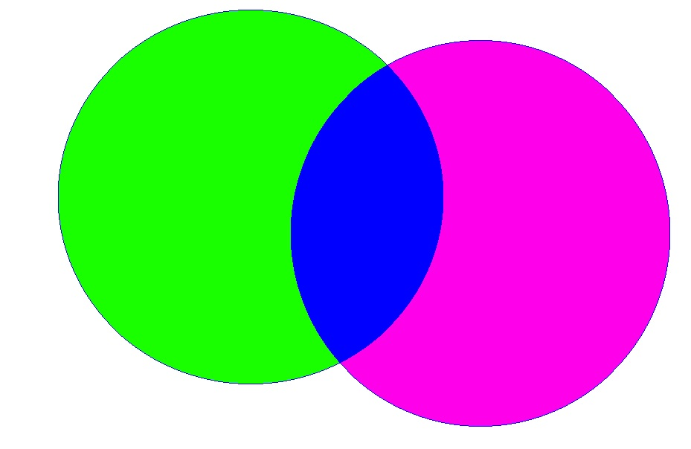
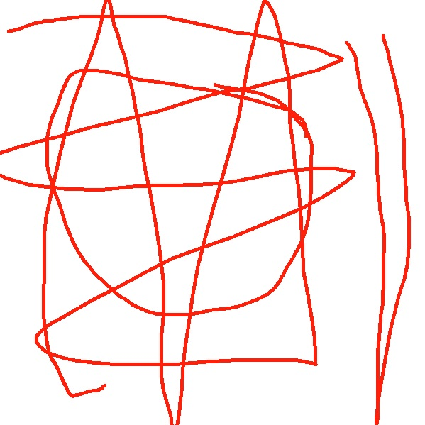
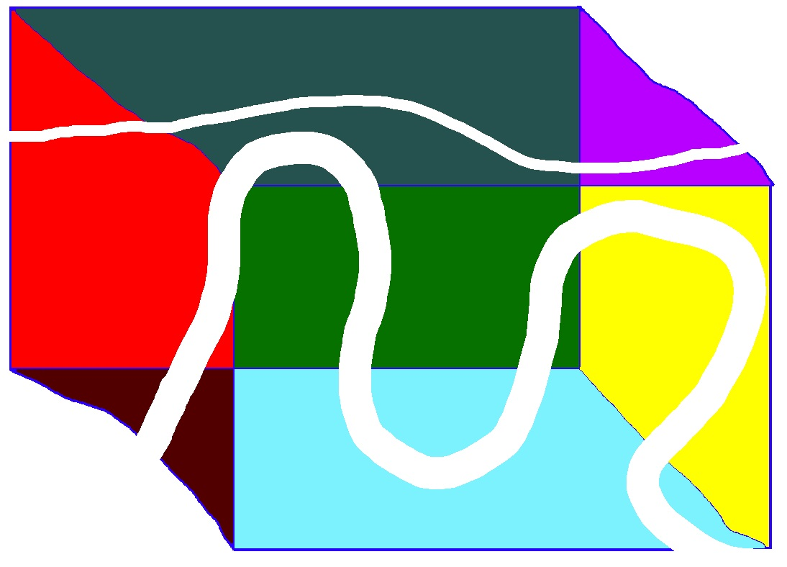
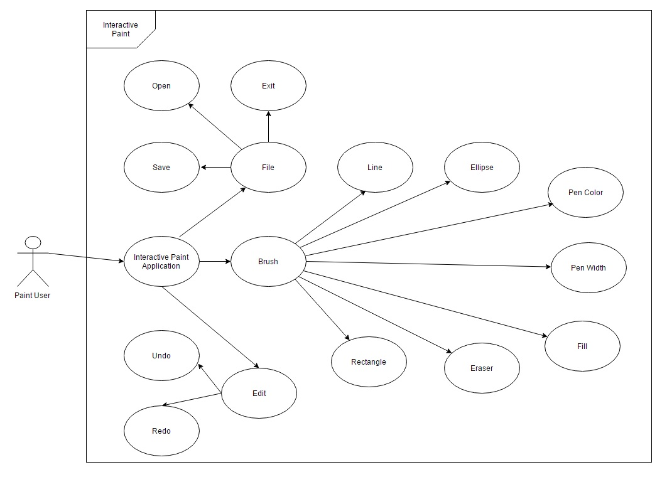
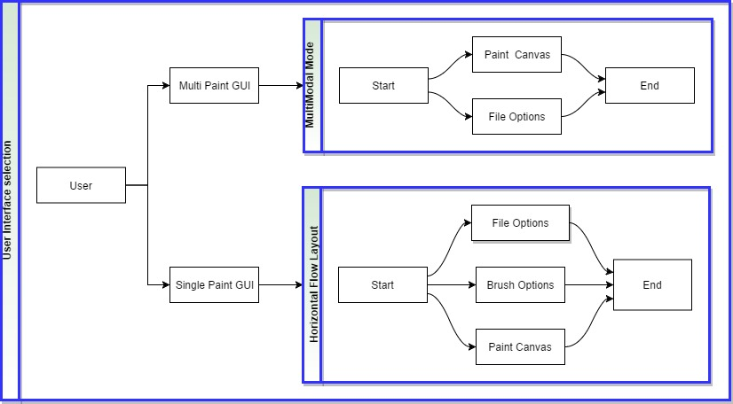



School of Computing & Information Sciences
Senior Project, 2017, Spring
Multi-Model Interactive Paint
Student: Daniel Mederos, Florida International University
Mentor: Francisco Ortega, Florida International University
Instructor: Masoud Sadjadi, Florida International University
Problem
Having an application work across multiple operating systems, with different requirements and programs, which requires maintenance and many changes
This project is a complete rewrite from the last iteration
Solution
Develop the GUI with the QT framework so that we can have a canvas that handles multiple pens in free draw along with a canvas that handles a single pen touch but gives the user more options on what drawing they could make. Do so having as few dependencies as possible.
Summary
Interactive Paint showcases the portability of the application
Future iterations will add more input devices
QT creates a higher level of abstraction when adding features
QT also reduces the amount of dependencies while being cross platform
Screenshots
Object Design
System Design
Verification
Test case: Undo
Purpose: Test to see if canvas can be restored to the second to last state
Preconditions: Must have a minimum of one action already on the canvas
Action: Paint user clicks on edit button and then clicks on undo button
Expected Result: The canvas returns to the second to last state before the user had done the action we are trying to undo
Current System
Support for many easy to use tools
Base code is modular, so it's easier to add features, refactor code and create facades
Interactive Paint is cross platform on any machine running QT
Supports multiple users at the same time on the same drawing canvas
Acceps up to 10 inpts under MultiModal mode
Requirements
As a user, I want to be able to have basic tools like New, Open, Save, Ellipse, Rectangle, Brush, and Color
As a user, I would like to have the Interactive Paint application to be cross platform
As a user, I would like to have the Interactive Paint application to support more than 2 users at the same time on the same Canvas
Implementation
This project Was built in C++ using the Qt framework
Classes that we used specific to Qt 4.8 and above include QtWidgets, QtApplication, and QtUtility.
We programmed and compiled code mostly in Visual Studios 15
Acknowledgement
The material presented in this poster is based upon the work supported by Dr. Francisco R. Ortega. I am thankful to the help that I received from my group member Jim Louro in the process of creating this software.
Notes:
‹#›

